Slide 1
FREEgx - Subset of product management and freelancing
The FYP Idea is to built a service based freelancing platform with an exceptional feature of software Management
FYP = ( JIRA + FIVER)
MEMBRES
SAAD
ANUS
A.SHAKOOR

Slide 2
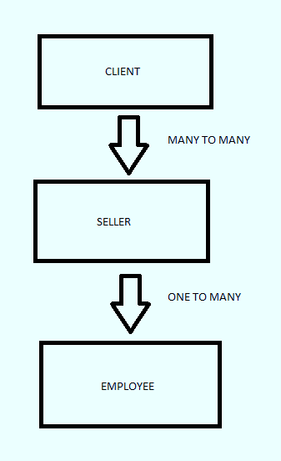
STACK HOLDERS
BUYER
SELLER
EMPLOYEE

Slide 3
HAVE’S AND DON’T HAVE IN fiverr
AVAILABLE
NOT AVAILABLE
BUYER
SELLER
BILLING
Messaging
LISTING
EMPLOYEE Account
Project management
Online Meet
Progress Status Report
WBS
Cancel order at any Instance
Billing partition

Slide 4
FLOW OF PROJECT
CLIENT:
CLIENT GOT WEBSITE
CLIENT REGISTER FORM
CLIENT LOGIN
SEARCH FOR RESPECTIVE WORK
SEE LISTINGS
CLICK LISTING
VIEW SELLER PROFILE
MESSAGES
PLACE ORDER
REQUEST FOR ONLINE MEETING
CLICK TO view the percentage of work completed
IF not satisfied , click to cancel order
The 60% income will be sended to seller and the project will not be move ahead.
If satisfied wait the state to be 100%. And complete amount will be sended to seller
Client provide review
Sign out

Slide 5
FLOW OF PROJECT
SELLER:
SELLER GOT WEBSITE
SELLER REGISTER FORM (IF NEW)
SELLER LOGIN
ADD GIGS (1-6 PAGES FOR GIGS)
INVITE EMPLOYEEs ( JUST WRITE EMAIL AND CLICK)
GENERATE WBS FROM WORK
At Start, the WBS ( suppose 10 wbs and not assigned state=0 , 6/10 completed state= 60%)
Chart shown x-axis ( employees) y-axis ( no of tasks)
Assign one by one to its employees
Accept request for meeting and start meet.
If project cancel in between. Inform employees to stop work
Wind up that project
Sign out

Slide 6
FLOW OF PROJECT
employee:
Got email from company for entering to portal ( Gmail shows credentials user/pass)
Click the given link and login.
Complete profile and save it
The associated task of that employee will be shown
Change the state of that WBS to ongoing
After completing ( generate pull request for git hub , NOTE : need to decode how will submit)
After work completed change the state to completed.
Sign out

Slide 7
THE END

